Slide 1
An Analysis of Crime
By: Rayhan Aurelio

Slide 2

Background
The dataset that we will use for this project contains information of every single arrest, that took place in the city of Los Angeles between the Years 2020 and 2022.
As of 2020, there are roughly 4 million people living in LA. [1]
The dataset contains attributes of every single report including the details of the victim and the premise of the incident, there are a total of 445,167 rows in this dataset[2]
PostgreSQL and Tableau will be used

Slide 3
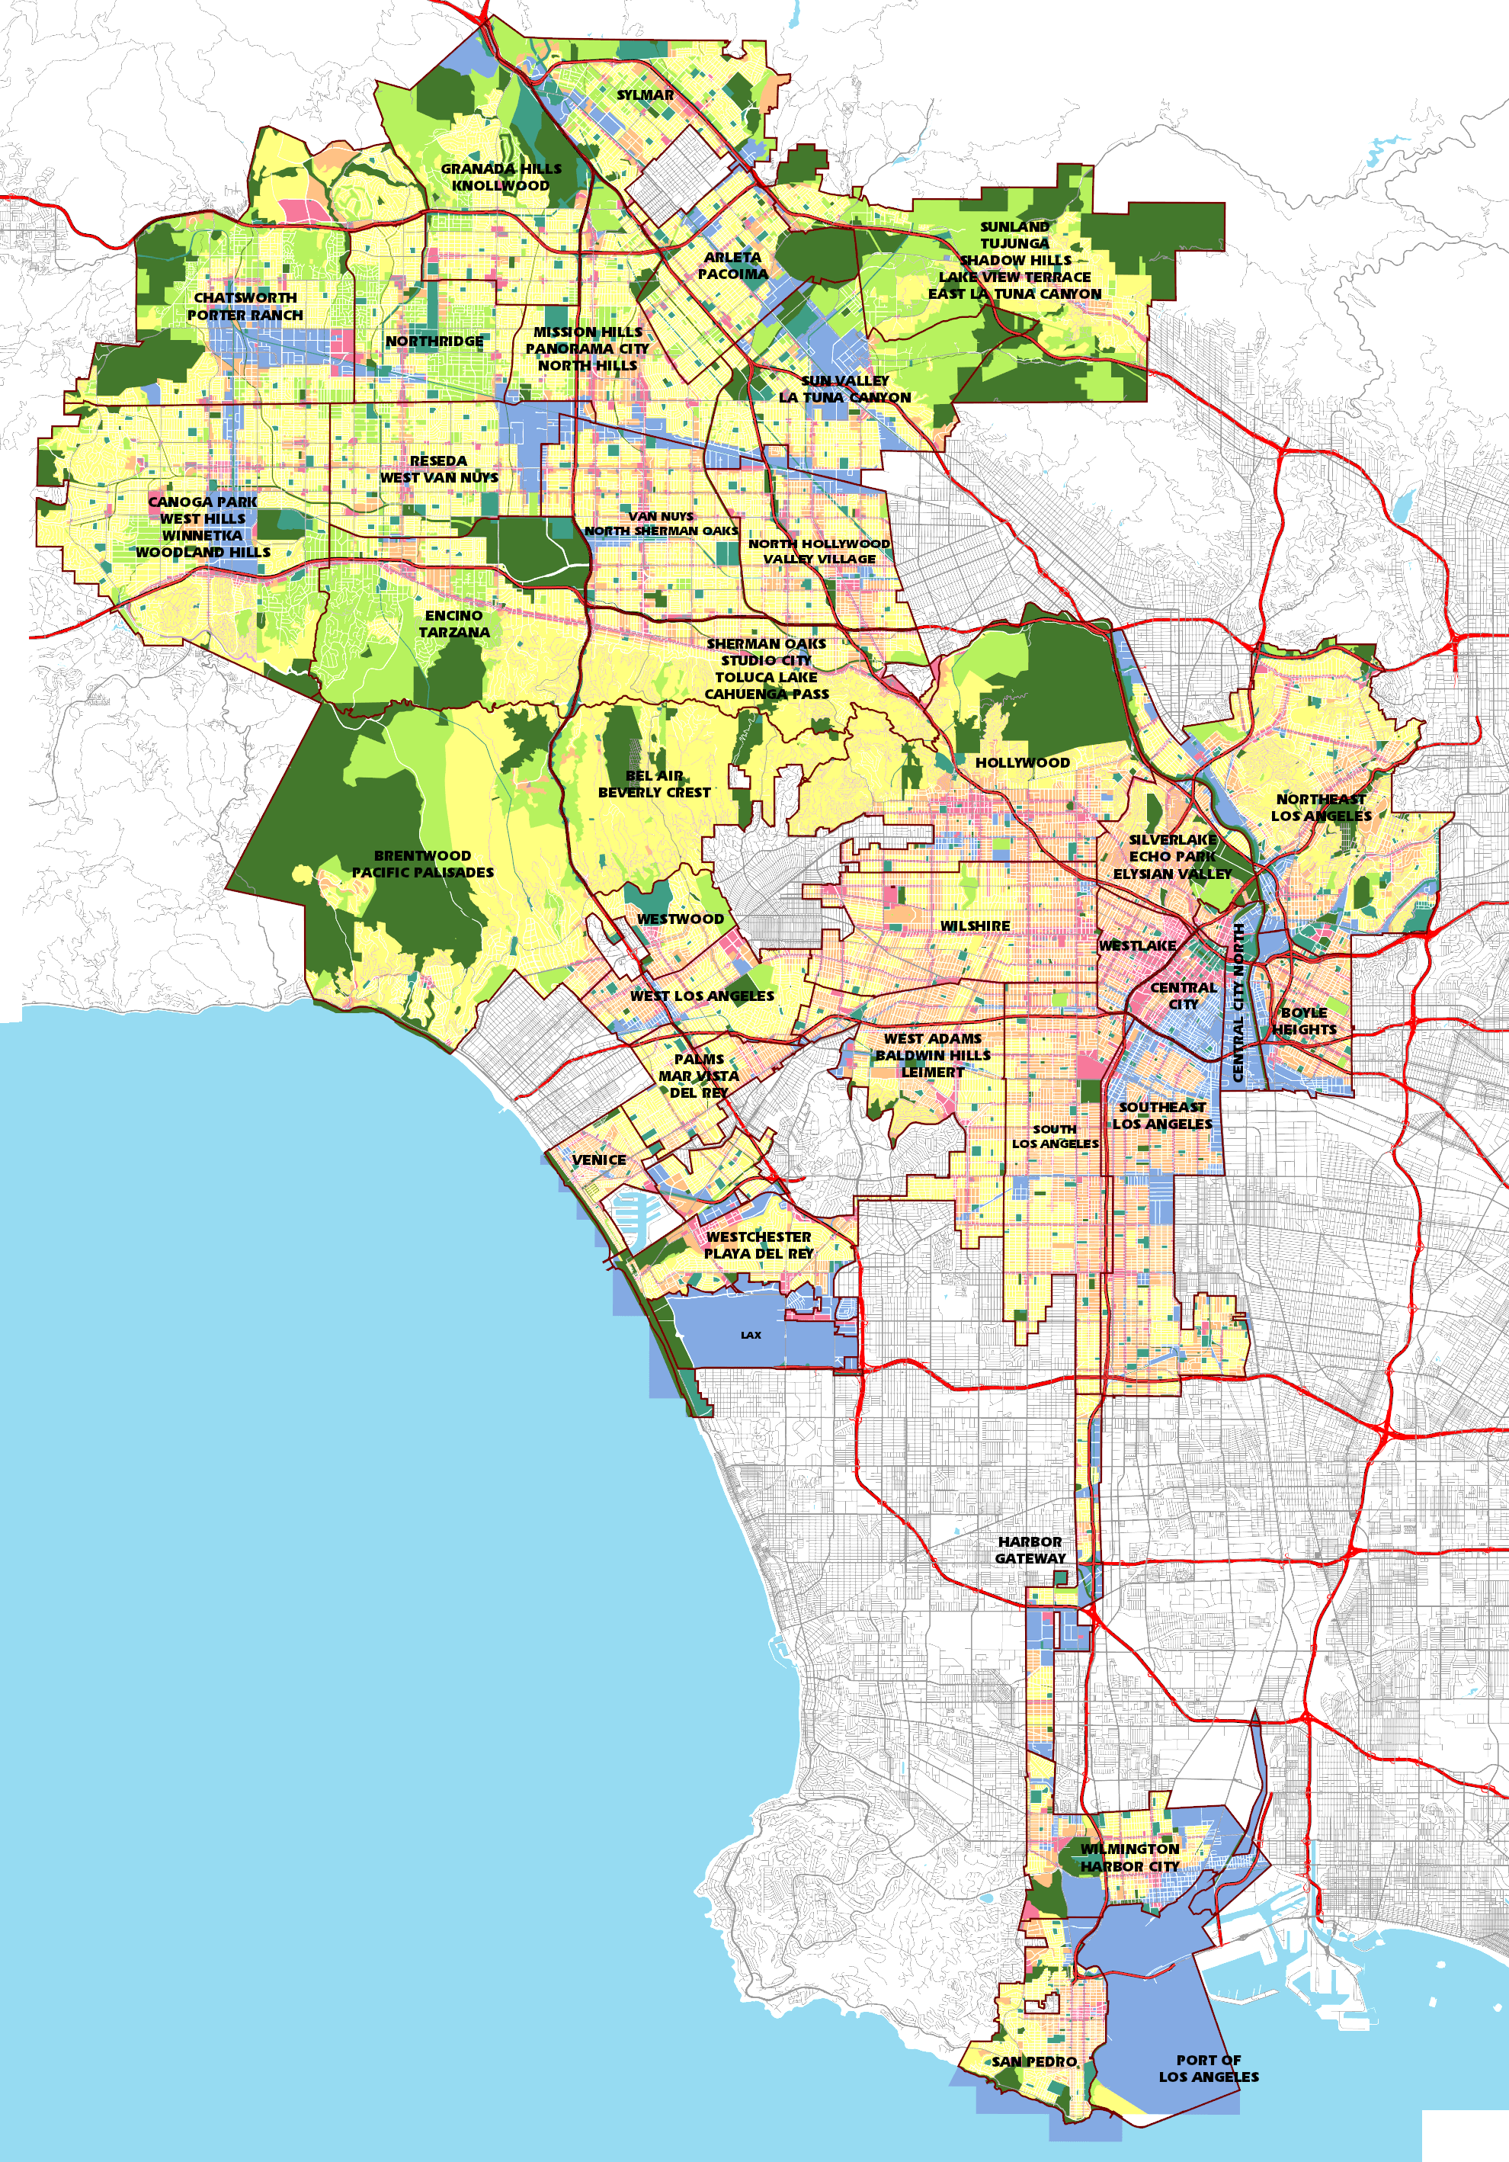
Am I in danger?
The city is divided into 21 zones.
Therefore, on average there are roughly 21,000 reports in every zone.
Disclaimer: I am purely looking at the statistics of this dataset, and do not condone any form of discrimination against the people living in it.

Slide 4
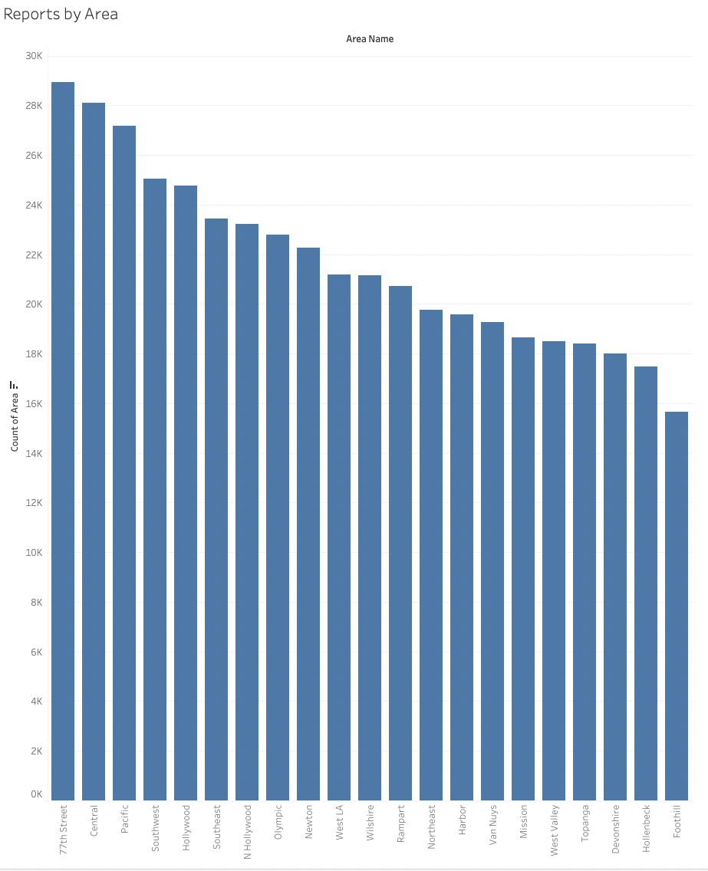
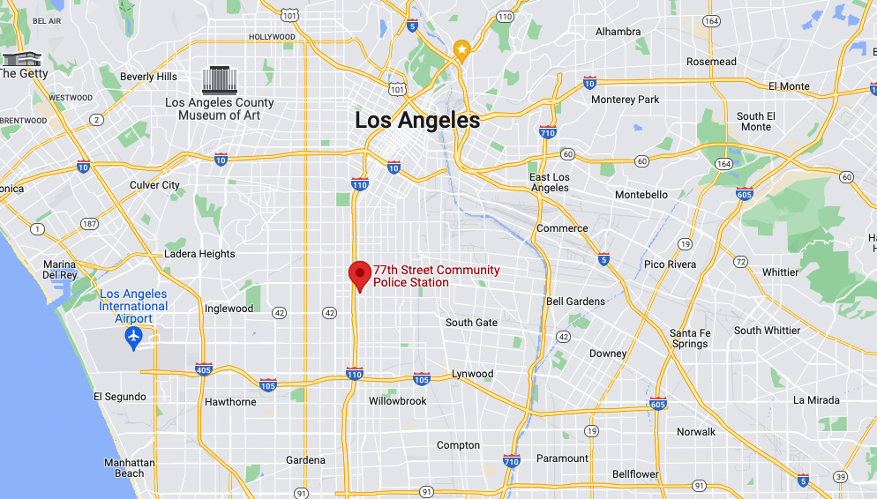
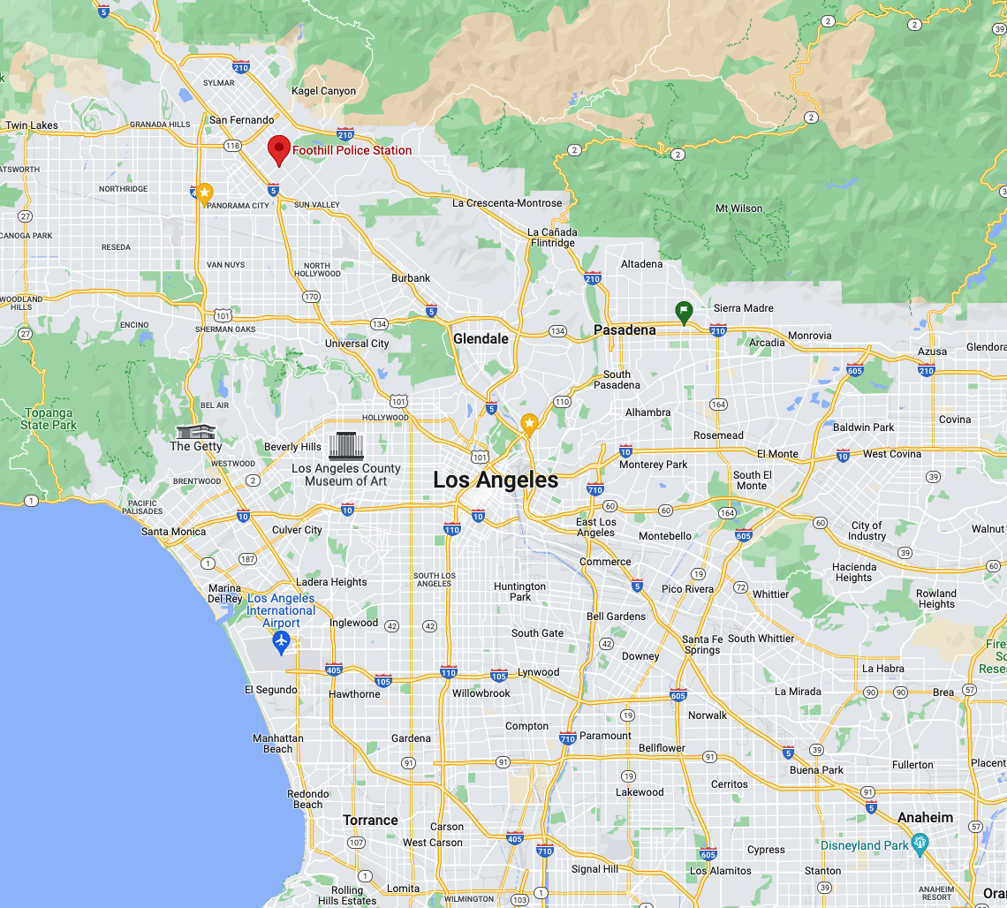
Zone 12 (77th Street) saw the most number of reports filed at 28,939 (6.50%) within the 2 years.
Zone 16 (Foothill) saw the least number of reports filed at 15,657 (3.52%) within the 2 years

Slide 5

Discrimination Scale
We will next be looking into the statistics of the victim in each report and check to see whether or not a certain group of people are being discriminated against (sex, and ethnicity).

Slide 6
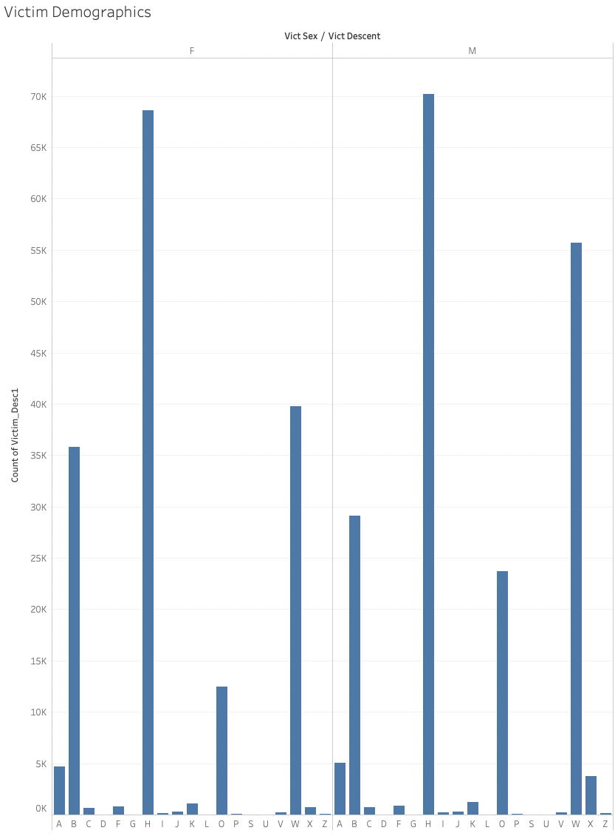
A - Other Asian
B - Black
C - Chinese
D - Cambodian
F - Filipino
G - Guamanian
H - Hispanic/Latin/Mexican
I - American Indian/Alaskan Native
J - Japanese
K - Korean
L - Laotian
O - Other
P - Pacific Islander S - Samoan
U - Hawaiian
V - Vietnamese
W - White
X - Unknown
Z - Asian Indian
As we can see from the visualization, victims are more likely to be male than female (191,300 vs. 165,386)
Both sexes also exhibit a similar trend in the ethnic background of each victim.
Hispanics
Caucasians
African Americans

Slide 7
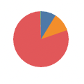
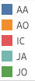
Status of crime
Most crimes end up with the investigation being continued, and only 41,471 reports end up in arrests.
Adult Arrested
Adult Other
Investigation Continued
Juvenile Arrested
Juvenile Other

Slide 8

Expecting the worst
We will next be looking at the most occurring crime in the city within the past 2 years, and check the premise at which it is occurring.

Slide 9
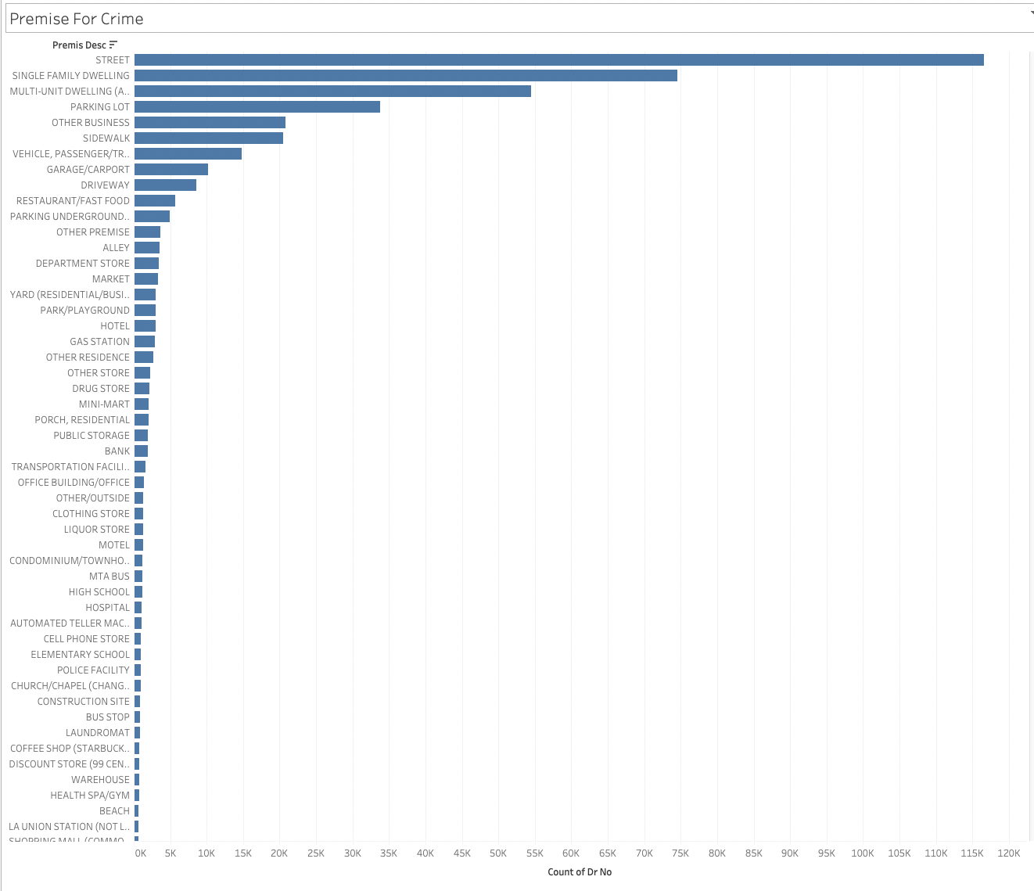

The street seems to be the most popular place for criminal activity:
Reason: There are various types of crime that can occur here.
Car/motorjacking
Drug dealing
Mugging

Slide 10

GUNS!
Next we will be looking at the firearm statistics of the city of LA, and see how they compare to the national average.
Overall, California is the 7th safest state in regards to gun violence at a rate of 7.9 compared to the national average of 13.55. [3]

Slide 11
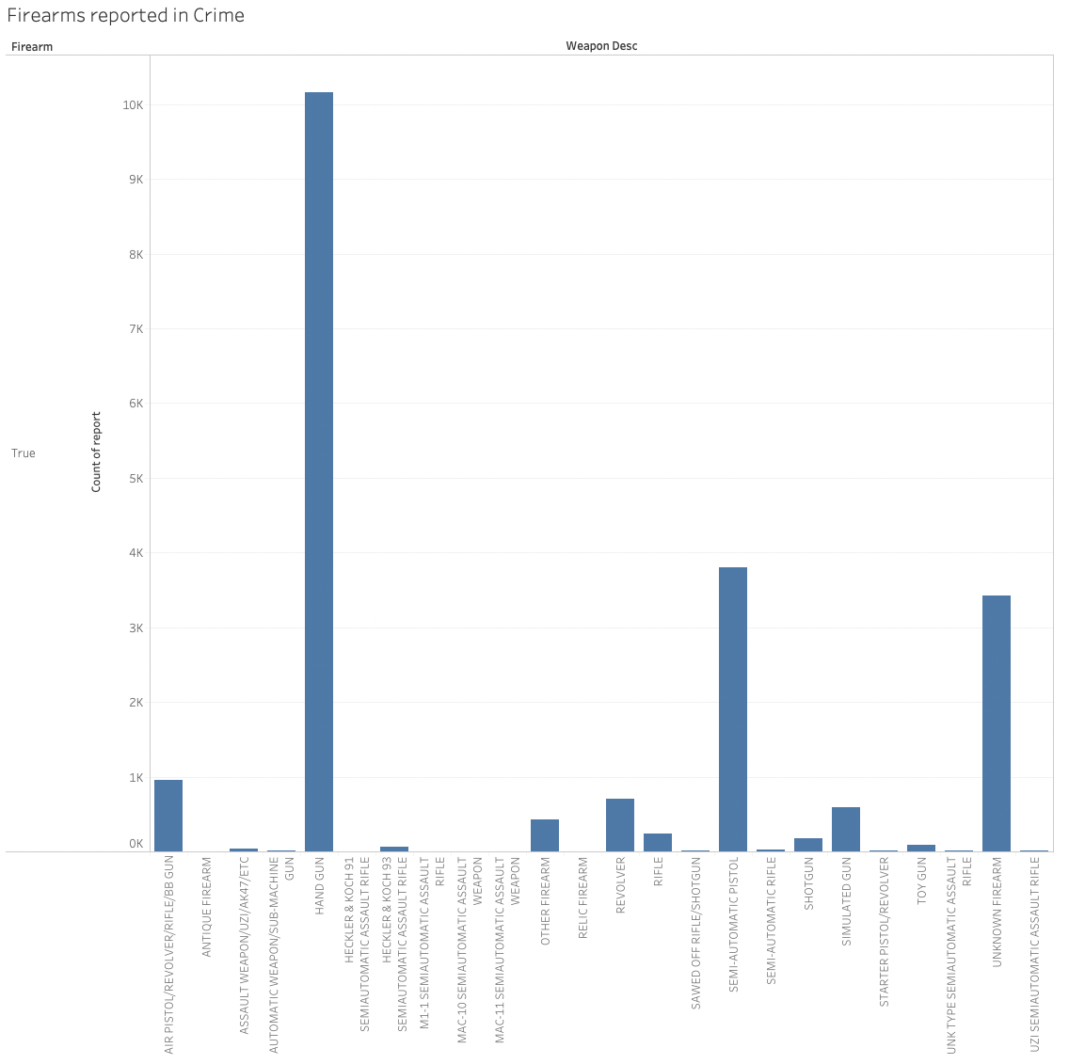
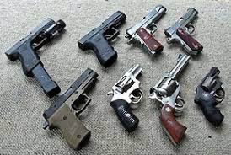
In the past 2 years, the city saw 20,752 firearm related incidents a rate of 4.67%, and assuming that all of them result in death as the previous slide, places Los Angeles way below California’s firearm related deaths.
Out of all of the firearm related incidents, hand guns seems to be favored by criminals (10,156 incidents), which might be due to it’s convenience and ease of concealment.

Slide 12

Thank you

Slide 13
References
1)https://www.census.gov/quickfacts/fact/table/losangelescitycalifornia/POP010220
2)https://data.lacity.org/Public-Safety/Crime-Data-from-2020-to-Present/2nrs-mtv8
3)https://worldpopulationreview.com/state-rankings/gun-violence-by-state

